Slide 1

NBA Shot
Prediction and Analysis
Cara You, Juan Brando, Pritisha Punukollu, Julie Liu, Albert Zhang

Slide 2



CONTENTS
- Introduction
- Data Cleaning & Exploration
- Modeling
- Clustering & Business Insights

Slide 3
Part 1: Introduction

Slide 4
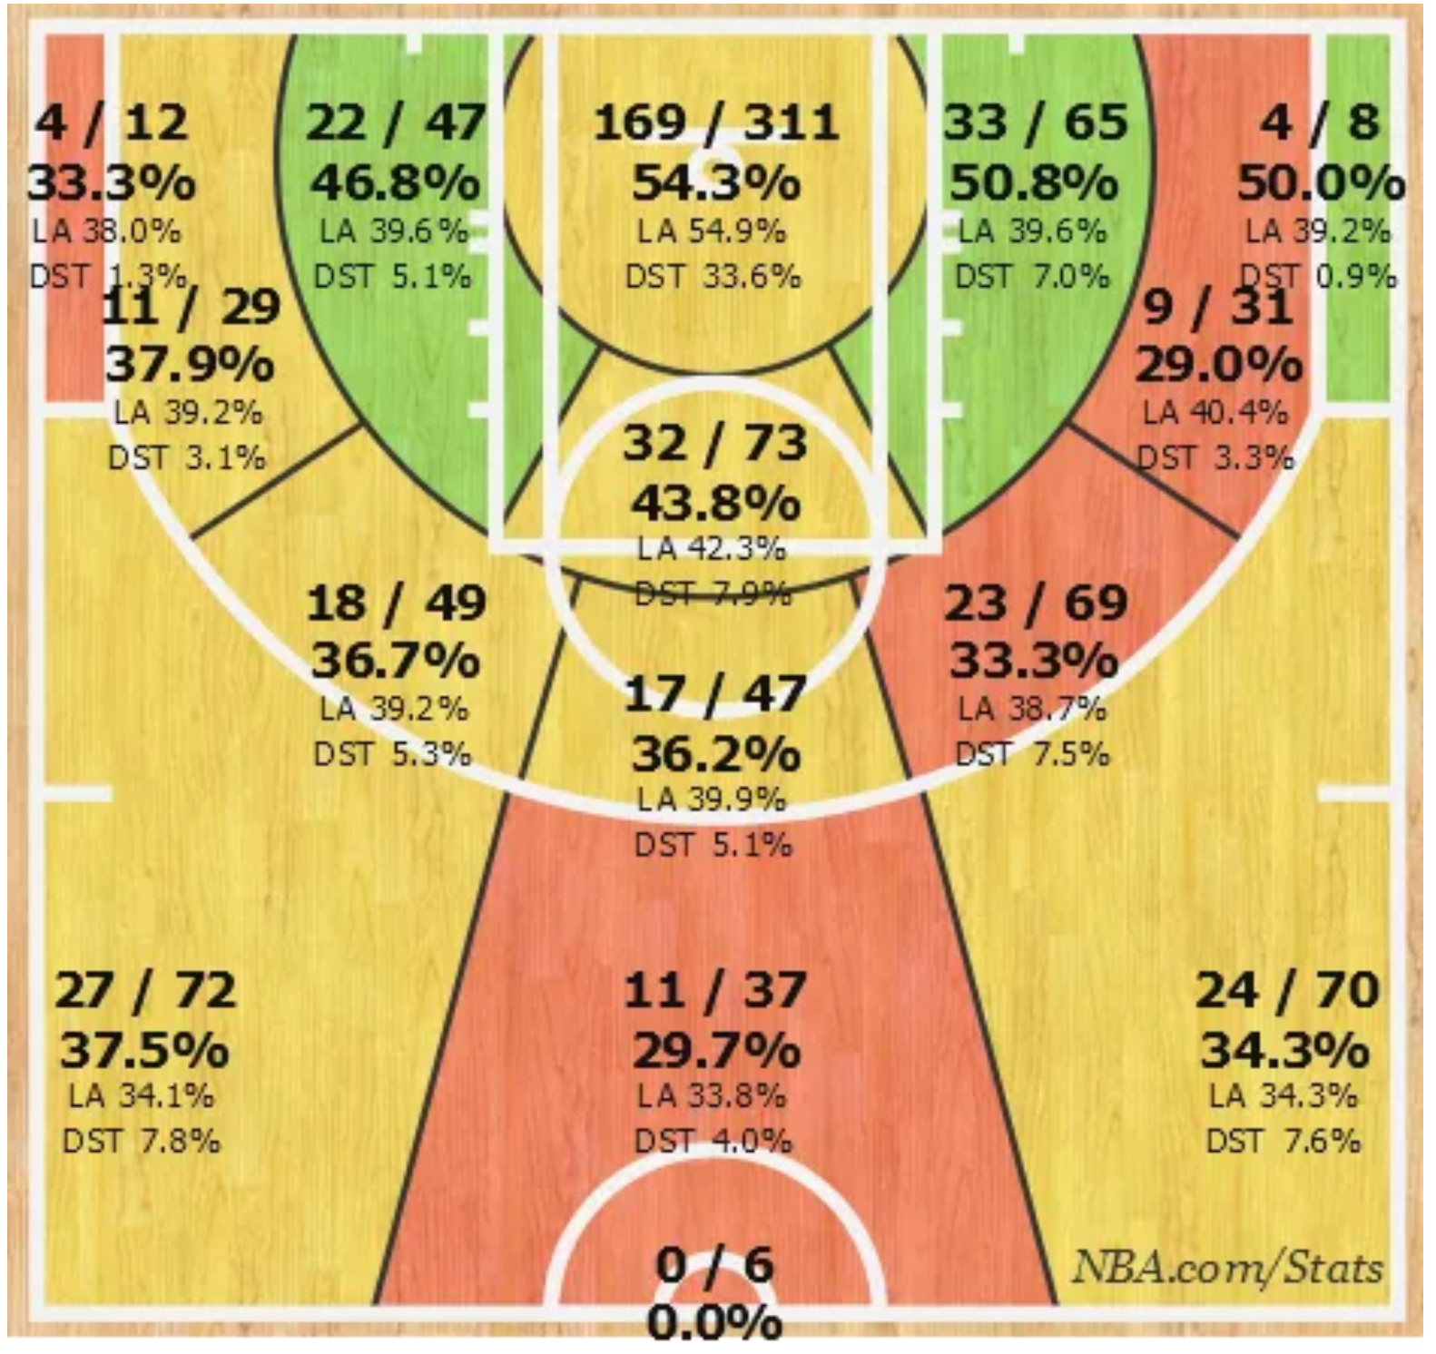
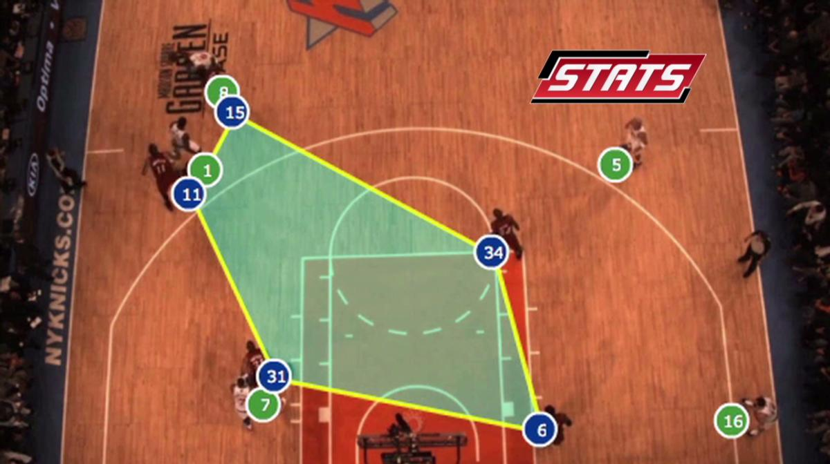
PART 1: Introduction – Business Understanding
Intro
Data Cleaning
Modeling
Clustering
Insights
NBA is a multibillion dollar league
SportVU cameras record every second of every game in the NBA
Games are close and a single shot might decide who wins
Ty Lawson shot chart
Notes:
$8 billion revenues per year
$1.9 billion average valuation per team

Slide 5
PART 2: Introduction - Data Understanding
Intro
Data Cleaning
Modeling
Clustering
Insights
Every shot attempted during the 2014-2015 NBA season
Game Situation (location, final margin, period, shot clock)
Shot being taken (distance from the rim, time holding the ball, number of dribbles)
Defender (distance from the shot taker)
Player Information
Feature Engineering
Physical characteristics (Height, weight, age)
Others (Yearly salary, experience, nationality)
Assisted shots
Corner 3’s
Open shots
Notes:
128K records

Slide 6
Part 2: Data Cleaning & Exploration

Slide 7
PART 2: Data Cleaning
Intro
Data Cleaning
Modeling
Clustering
Insights
Treating Nulls
Spurious Values
Sense Checks
Dummy Variables
Additional Columns

Slide 8
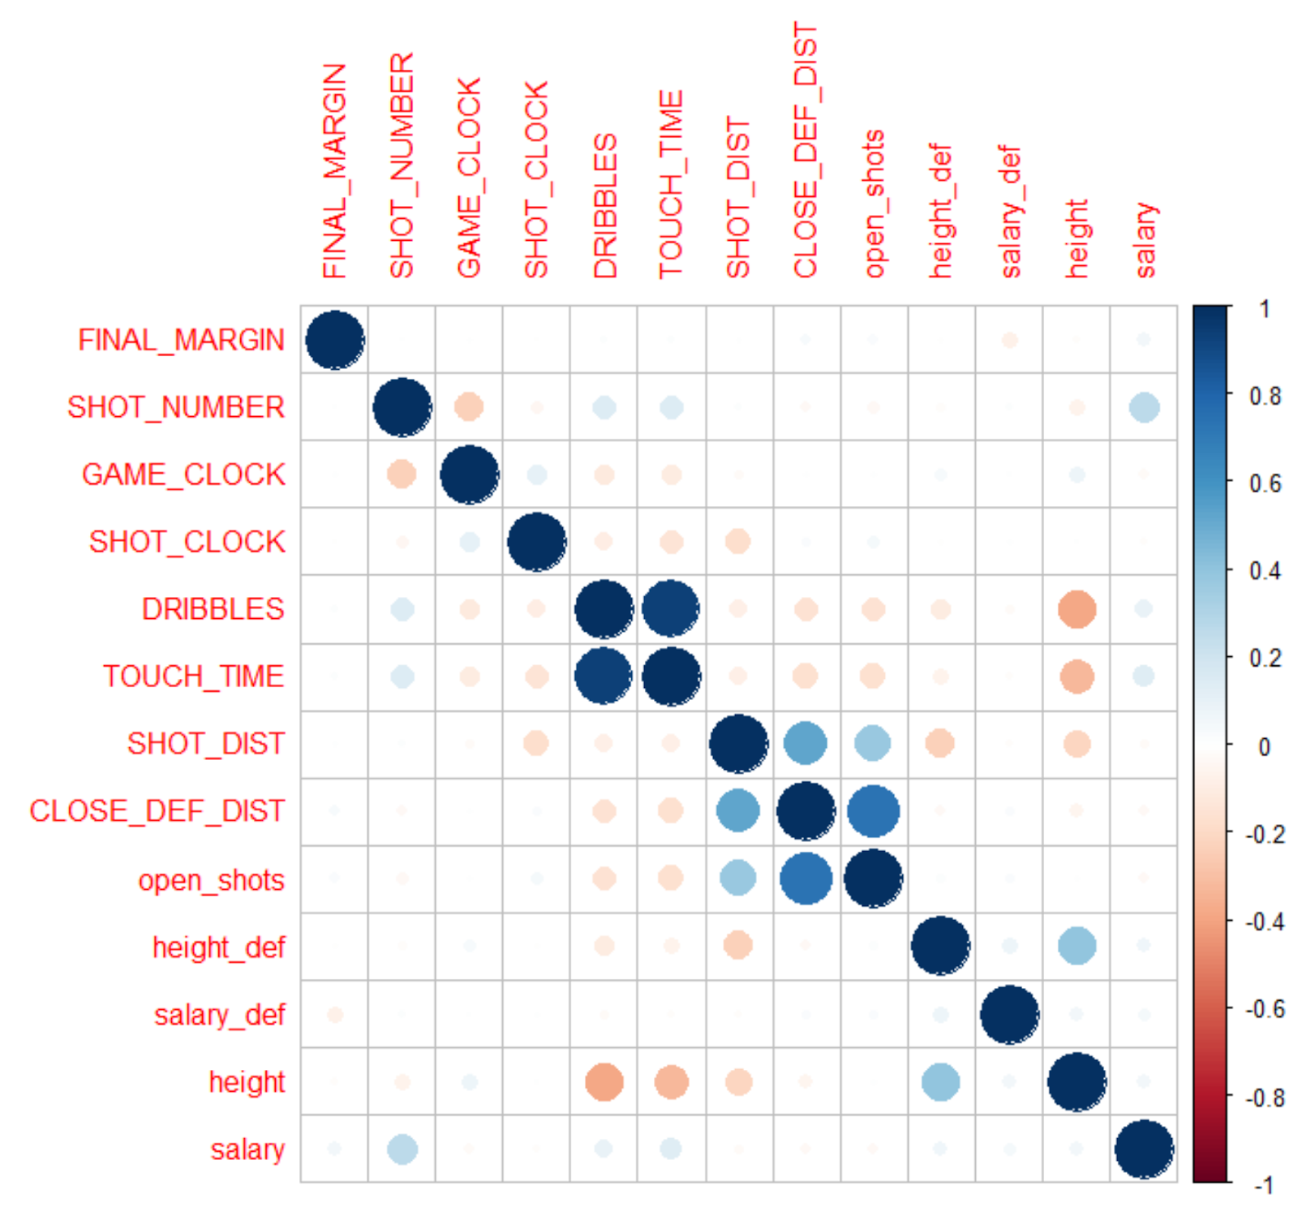
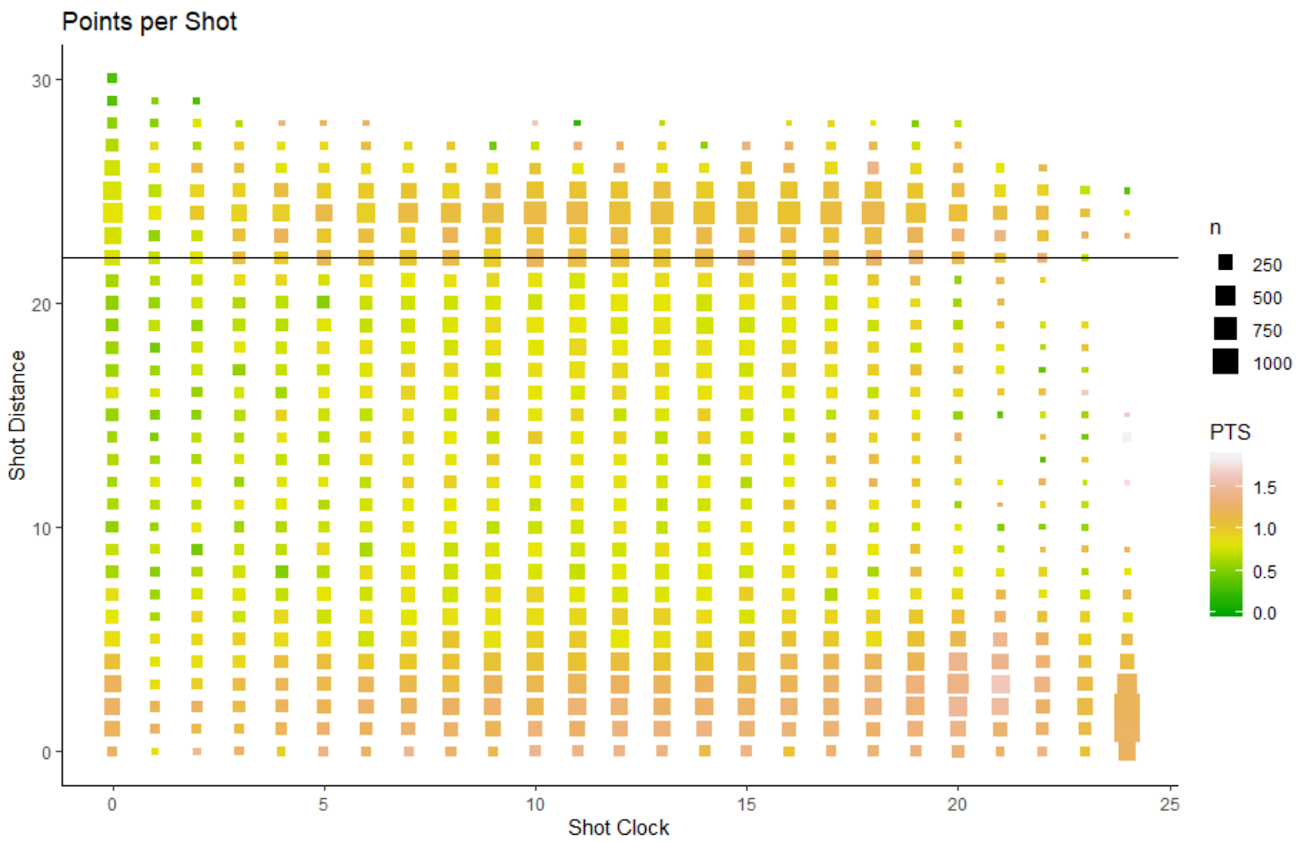
PART 2: Data Exploration
Intro
Data Explore
Modeling
Clustering
Insights

Slide 9
Part 3: Modeling (Logistic & Random Forest)

Slide 10
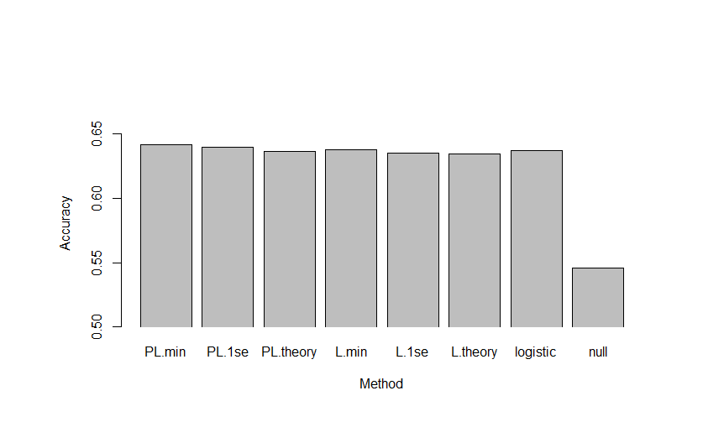
PART 3: Modeling – Logistic Regression
Intro
Data Cleaning
Modeling
Clustering
Insights
Dependent Variable: whether a player make a successful shot or not
Independent Variables: shot data and player characteristics
Method: Lasso
Best model: PL.min (49 variables selected)

Slide 11
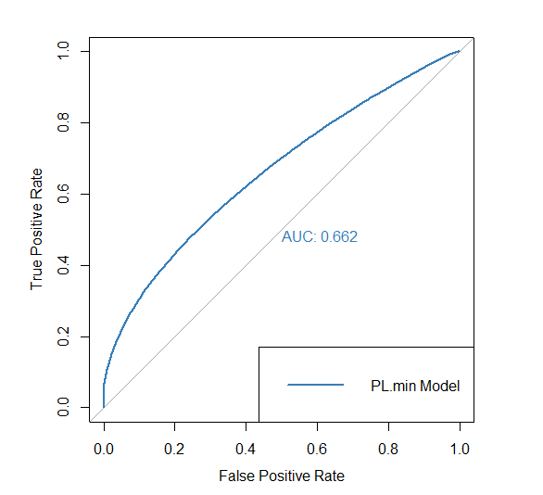
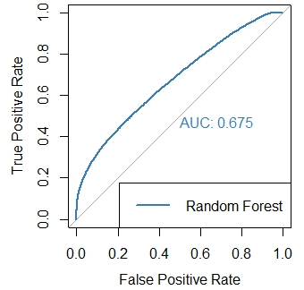
PART 3: Modeling – Random Forest
Intro
Data Cleaning
Modeling
Clustering
Insights
PL.min Model
Random Forest

Slide 12
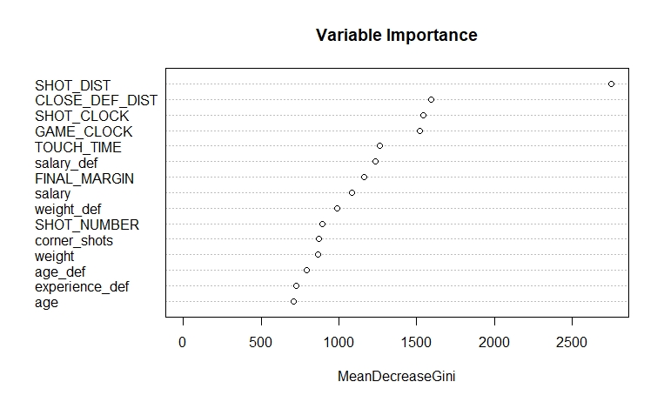
PART 3: Modeling – Random Forest
Intro
Data Cleaning
Modeling
Clustering
Insights

Slide 13
Part 4: Clustering

Slide 14
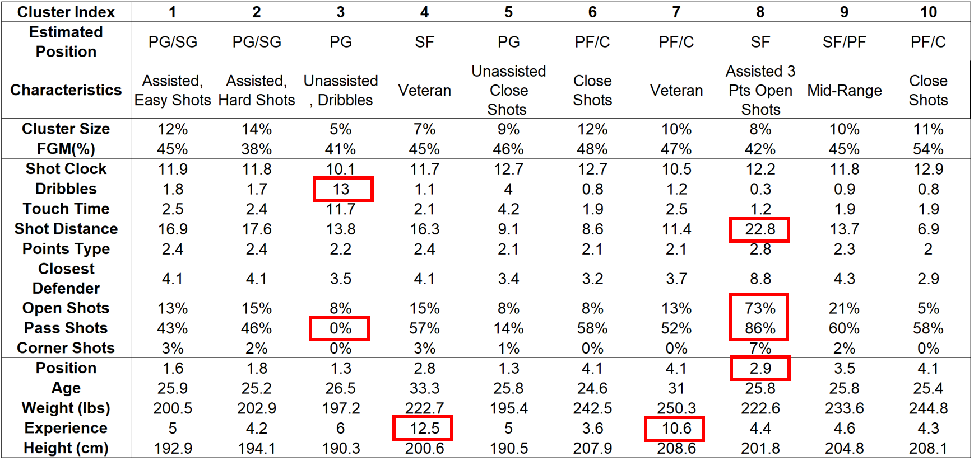
PART 4: Clustering
Intro
Data Cleaning
Modeling
Clustering
Insights

Slide 15
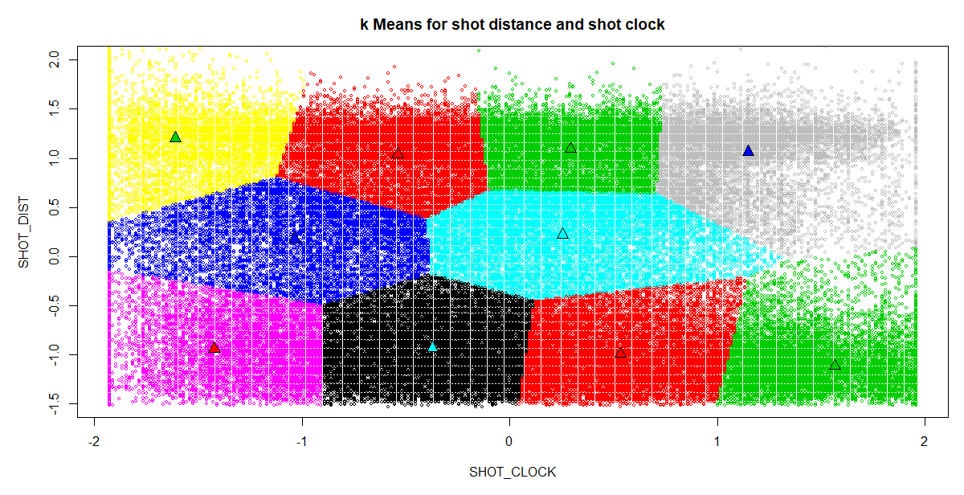
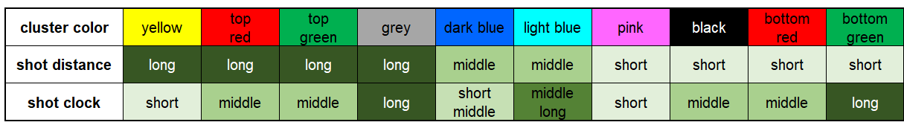
PART 4: Clustering
Intro
Data Cleaning
Modeling
Clustering
Insights

Slide 16
Part 5: Business Insights & Deployment

Slide 17
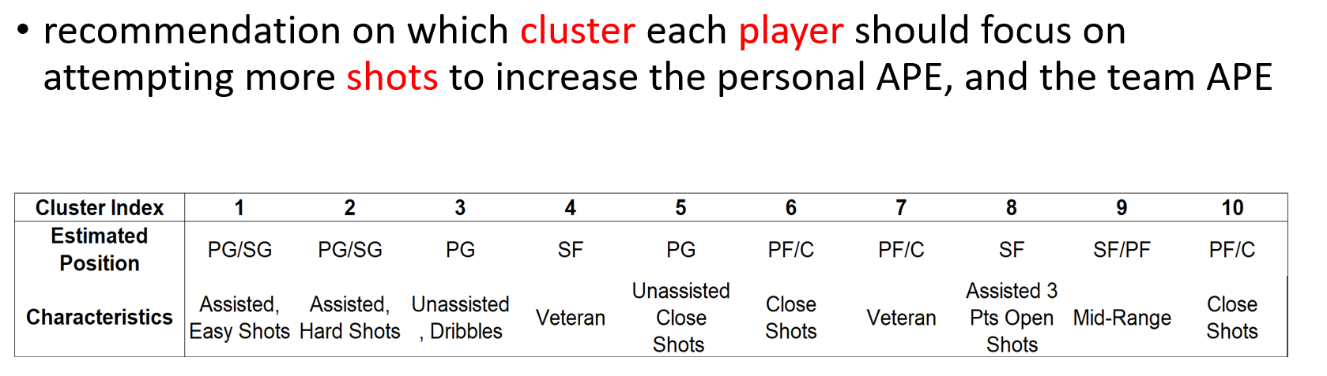
PART 5: Business Insights & Deployment
Intro
Data Cleaning
Modeling
Clustering
Insights

Slide 18

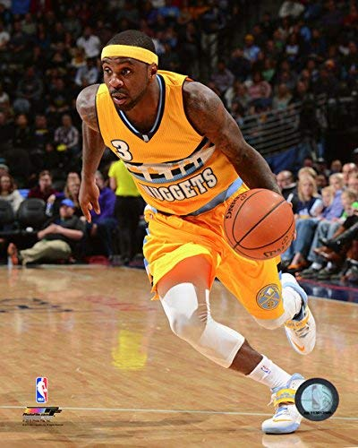


Slide 19
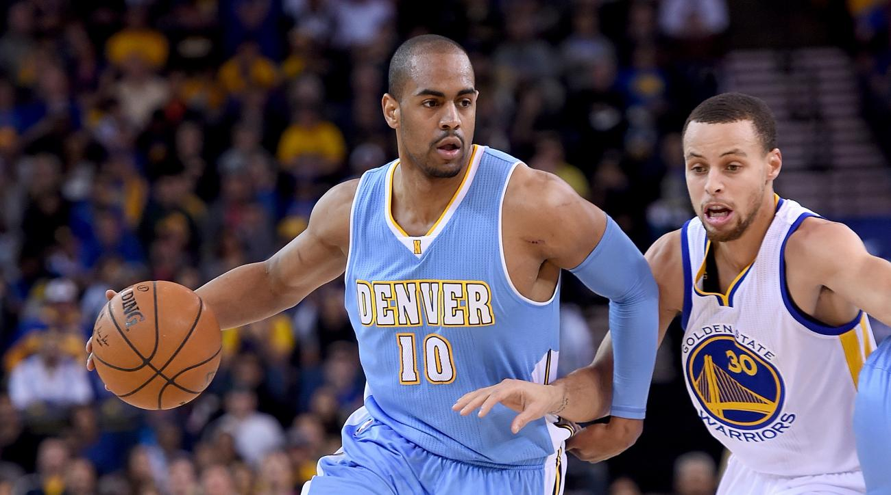

Slide 20
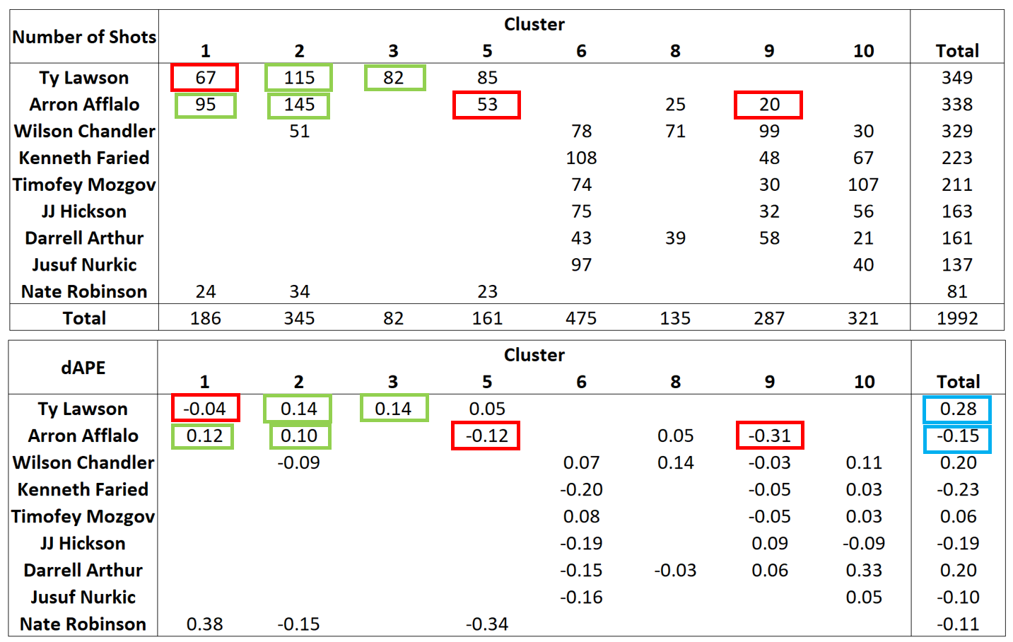
PART 5: Business Insights & Deployment
Intro
Data Cleaning
Modeling
Clustering
Insights

Slide 21
Externality:
Apply to other teams
Develop strategies against rivals
Apply to recent seasons

Slide 22
THANKS FOR YOUR LISTENING

